Slide 1
KOORDYNATOR
Complete Event Management Solution

Slide 2
Description of Project
The main purpose of this is provide a solution for Event Management. Mainly co-ordintate different persons involved in the process of coordinating people. Failure of most events occur due to bad planning and manage people. It will reduce paper work as well as save time money and money which is used for managing people. The project have big scope to do. Provides portal for registration of participant and volunteers according to the events. Provide participant details, Volunteer details and qr code scan and read facilities.

Slide 3
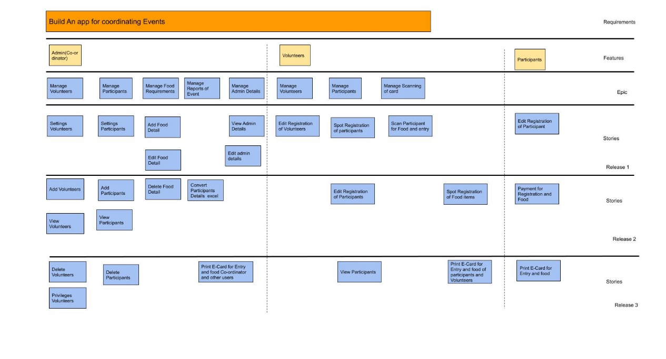
User Story

Slide 4

DFD

Slide 5


Slide 6


Slide 7
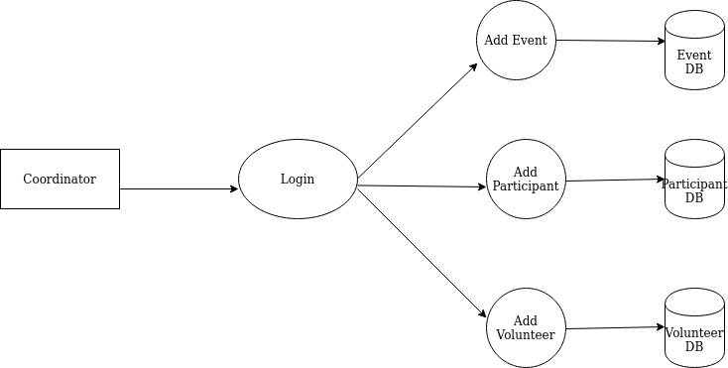
Level 2

Slide 8
Table Design - Coordinators
Field | Type | Constraints
Name | String | Required
Email | String | Required
Password | String | Required
Companyname | String | Not Required
Date | Date | Required
Notes:
<number>

Slide 9
Events
Field | Type | Constraints
Title | String | Required
EventType | String | Required
Description | String | Required
Volunteer | Boolean | Not Required
Coordinator | ObjectId | Foreign Key

Slide 10
Participants
Field | Type | Constraints
Name | String | Required
Email | String | Required
Address | String | Required
Company | String | Not Required
Event | ObjectId | Foreign Key

Slide 11
Volunteer
Field | Type | Constraints
Name | String | Required
Email | String | Required
Address | String | Required
Company | String | Not Required
Event | ObjectId | Foreign Key

Slide 12
Activities
Field | Type | Constraints
Name | String | Required
Value | Boolean | Required

Slide 13
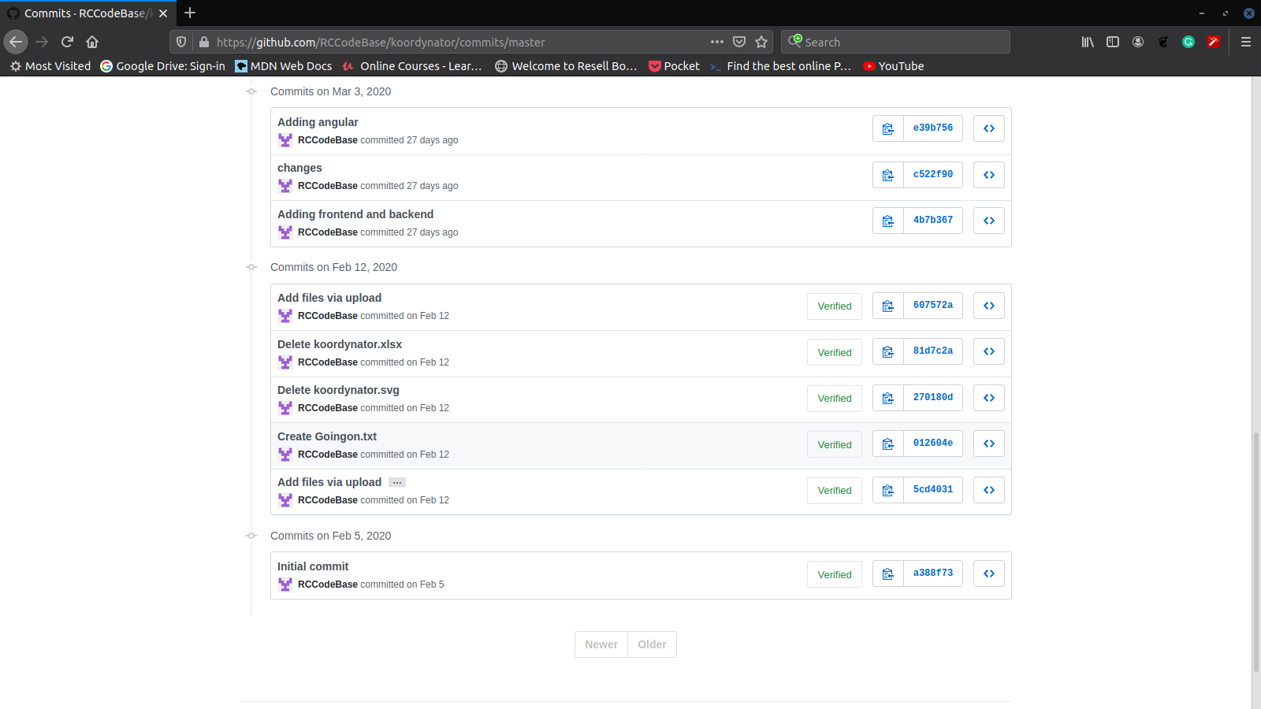
Git History

Slide 14
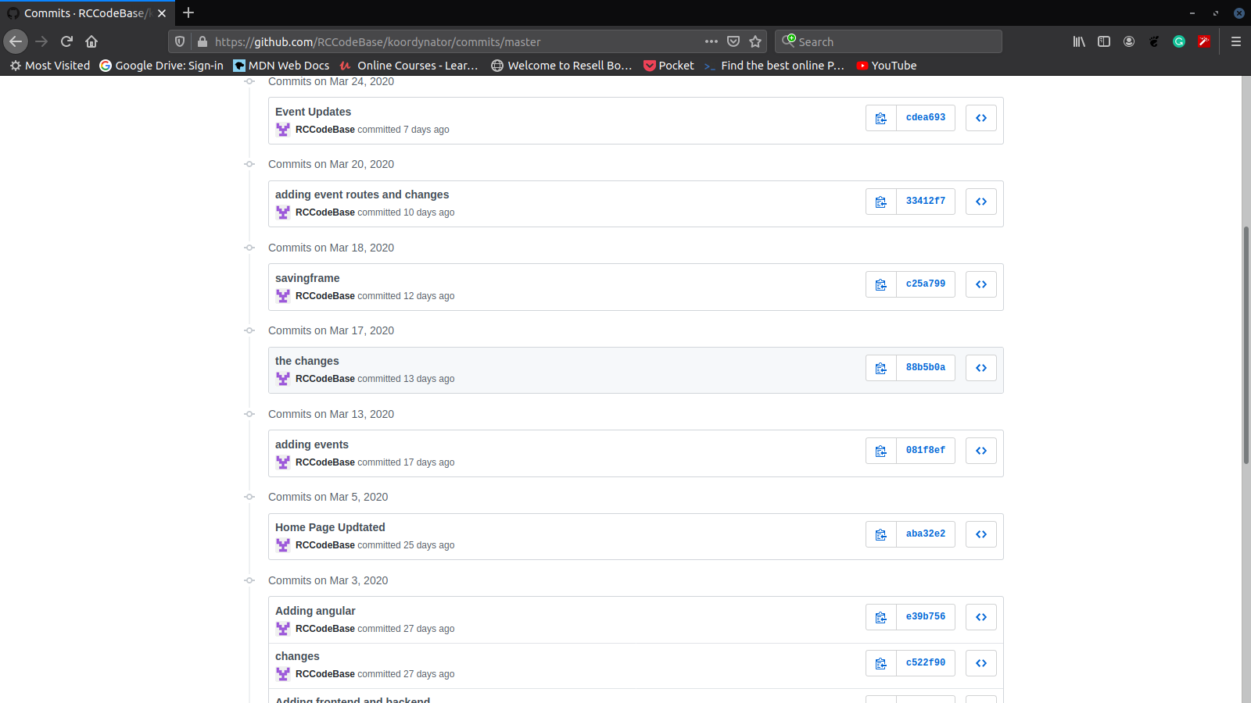

Slide 15
